Slide 1
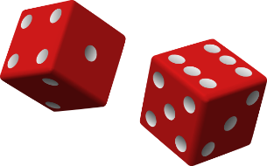
Probability and Combinatorics
The science of uncertainty… and gambling
Yordan Darakchiev
Technical Trainer
iordan93@gmail.com

Slide 2
sli.do #MathForDevs

Slide 3
Table of Contents
Probability
Combinatorics
Algebra of events
Conditional probability
Applications
Statistical distributions
Central limit theorem

Slide 4
Probability
Definition and principles

Slide 5
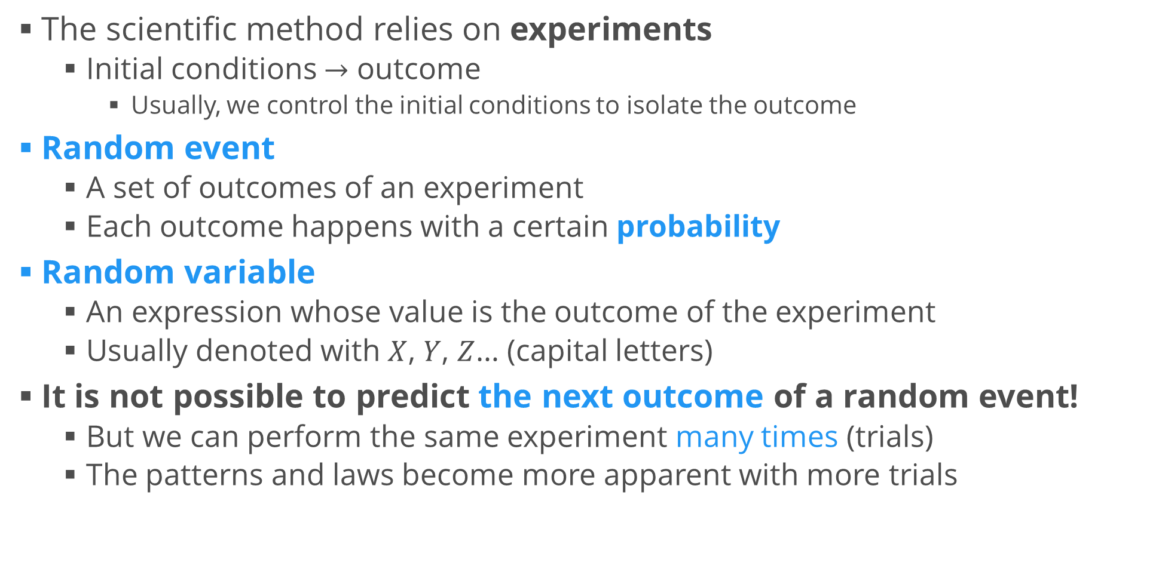
Some Definitions
The scientific method relies on experiments
Initial conditions $→$ outcome
Usually, we control the initial conditions to isolate the outcome
Random event
A set of outcomes of an experiment
Each outcome happens with a certain probability
Random variable
An expression whose value is the outcome of the experiment
Usually denoted with $X$, $Y$, $Z$… (capital letters)
It is not possible to predict the next outcome of a random event!
But we can perform the same experiment many times (trials)
The patterns and laws become more apparent with more trials

Slide 6
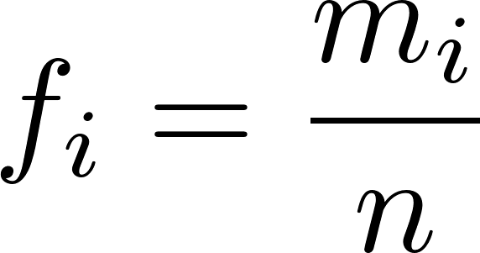
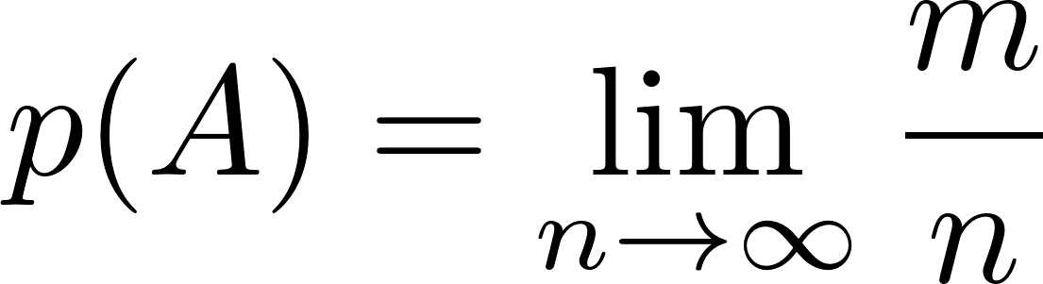
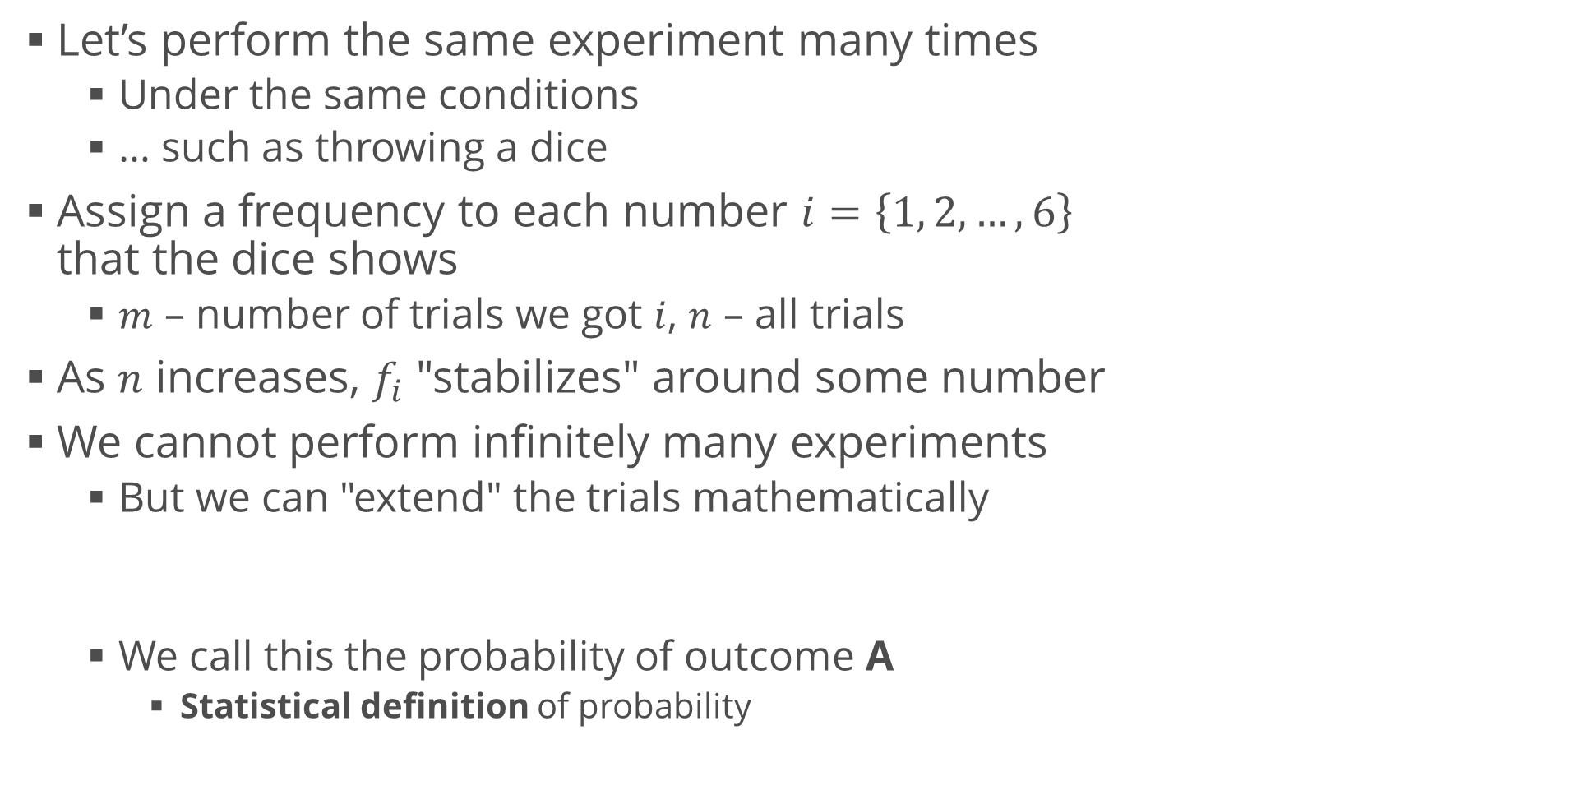
Frequency
Let’s perform the same experiment many times
Under the same conditions
… such as throwing a dice
Assign a frequency to each number $i=\left\{1, 2, …, 6\right\}$ that the dice shows
$m$ – number of trials we got $i$, $n$ – all trials
As $n$ increases, $f_{i}$ "stabilizes" around some number
We cannot perform infinitely many experiments
But we can "extend" the trials mathematically
We call this the probability of outcome A
Statistical definition of probability

Slide 7
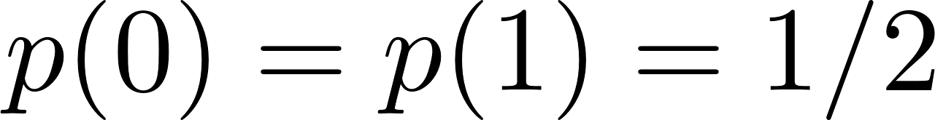
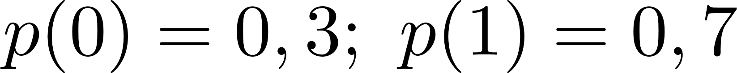
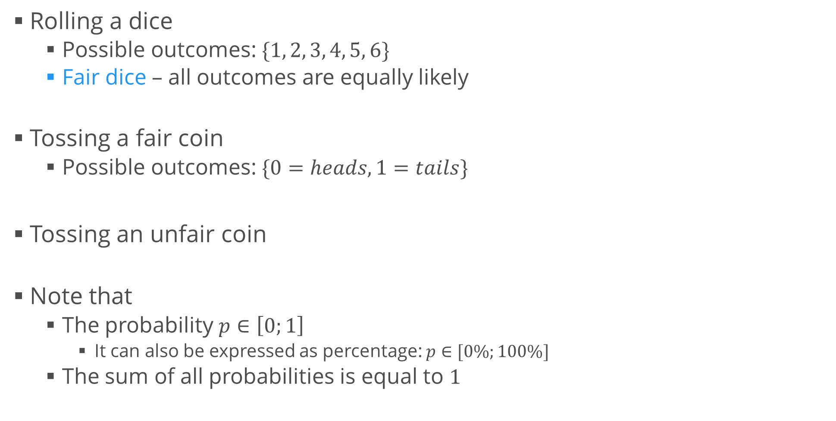
Examples
Rolling a dice
Possible outcomes: $\{1, 2, 3, 4, 5, 6\}$
Fair dice – all outcomes are equally likely
Tossing a fair coin
Possible outcomes: $\{0=heads, 1=tails\}$
Tossing an unfair coin
Note that
The probability $p∈\left[0;1\right]$
It can also be expressed as percentage: $p∈[0\%;100\%]$
The sum of all probabilities is equal to $1$

Slide 8
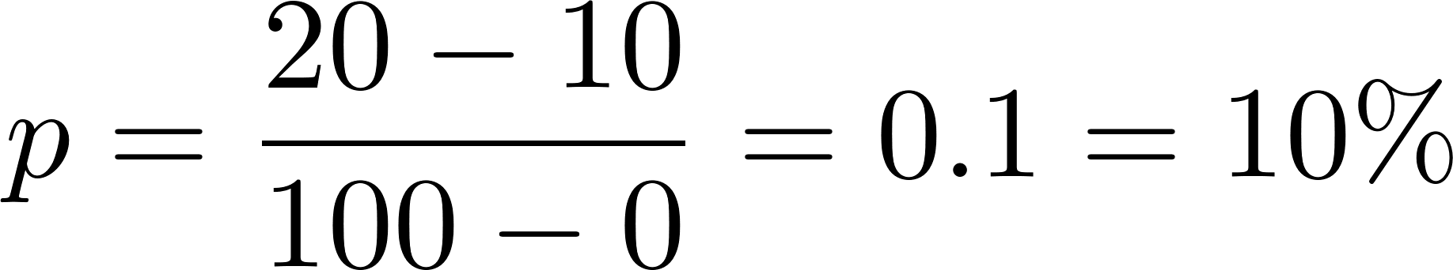
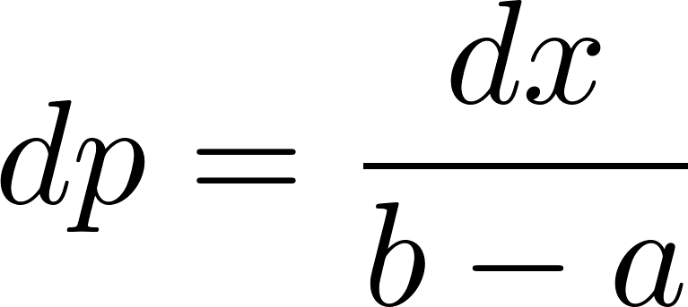
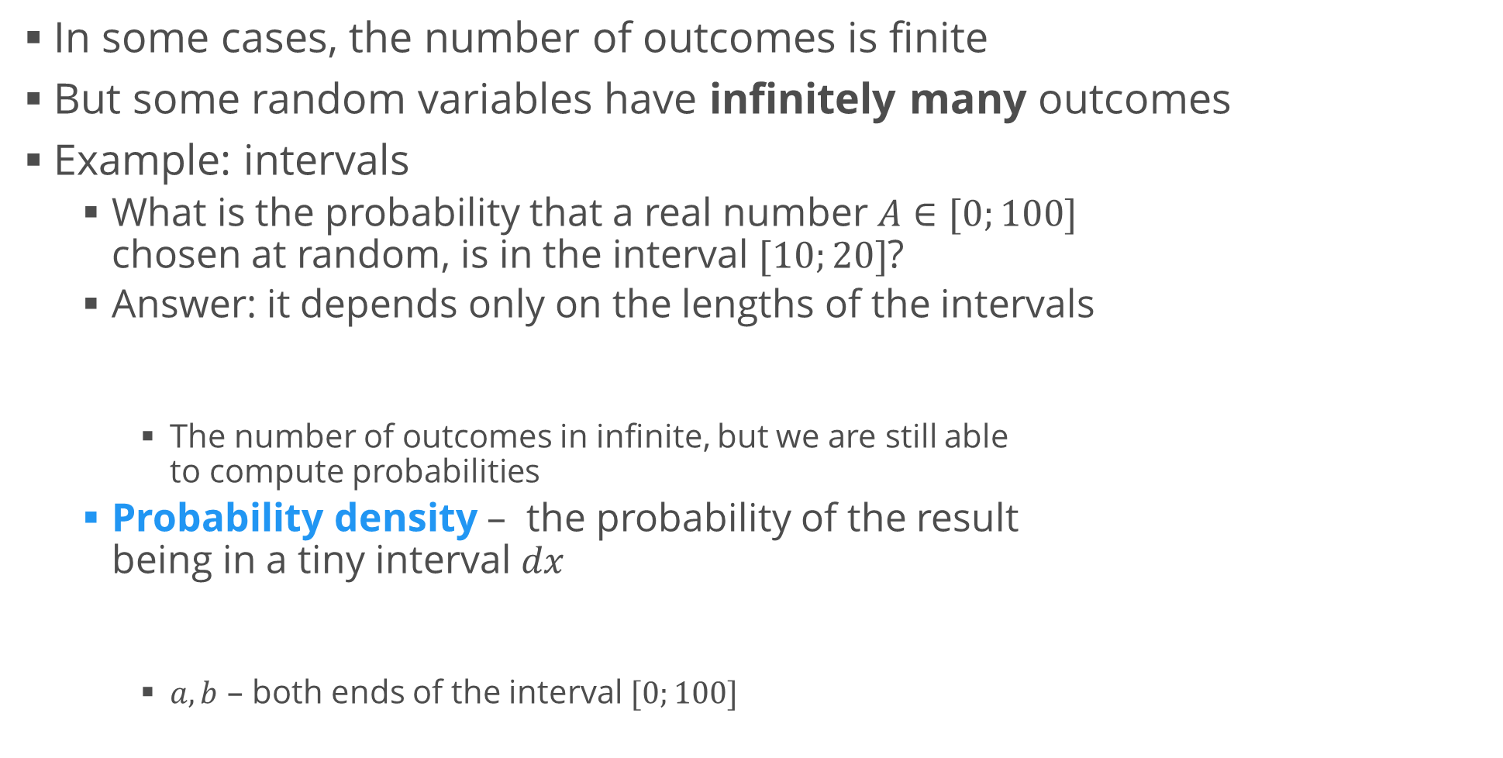
Countable and Uncountable Outcomes
In some cases, the number of outcomes is finite
But some random variables have infinitely many outcomes
Example: intervals
What is the probability that a real number $A∈[0;100]$ chosen at random, is in the interval $[10;20]$?
Answer: it depends only on the lengths of the intervals
The number of outcomes in infinite, but we are still able to compute probabilities
Probability density – the probability of the result being in a tiny interval $dx$
$a, b$ – both ends of the interval $[0;100]$

Slide 9
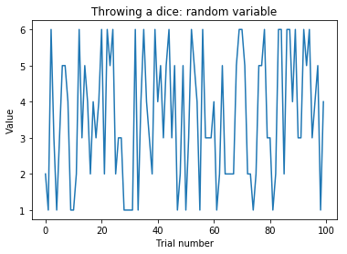
Visualizing Random Variables
To visualize a random variable, we plot the value as a function of the trial number
We can generate random values using numpy
Example: throwing a dice
def throw_dice():
return np.random.randint(1, 7) # from 1 to 6
x = [throw_dice() for i in range(100)]
plt.plot(x)
plt.show()

Slide 10
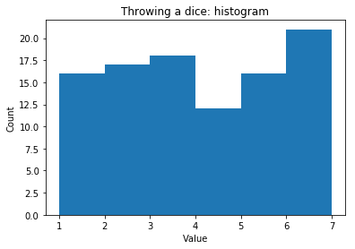
Visualizing Random Variables (2)
The function we got is not very informative
Better way: show the frequency of each output
For each possible value of the random variable, count how many times we got that value
This is called a histogram
# Counting all values
from collections import Counter
counts = Counter(x)
for number, count in counts.items():
print(str(number) + ": " + str(count))
# Plotting a histogram
plt.title("Throwing a dice: histogram")
plt.hist(x, bins = range(1, 8))
plt.ylabel("Count")
plt.show()

Slide 11
Combinatorics
How to count things

Slide 12
Combinatorics
Combinatorics deals with counting objects and groups of objects
Prerequisites
Finite (countable) number of outcomes
All outcomes have equal probability
Examples: gambling games
Roulette – all segments are equally likely
Card games – all card backs are the same
Counting rules
Rules for computing a combinatorial probability
Show how many "desired" outcomes exist

Slide 13
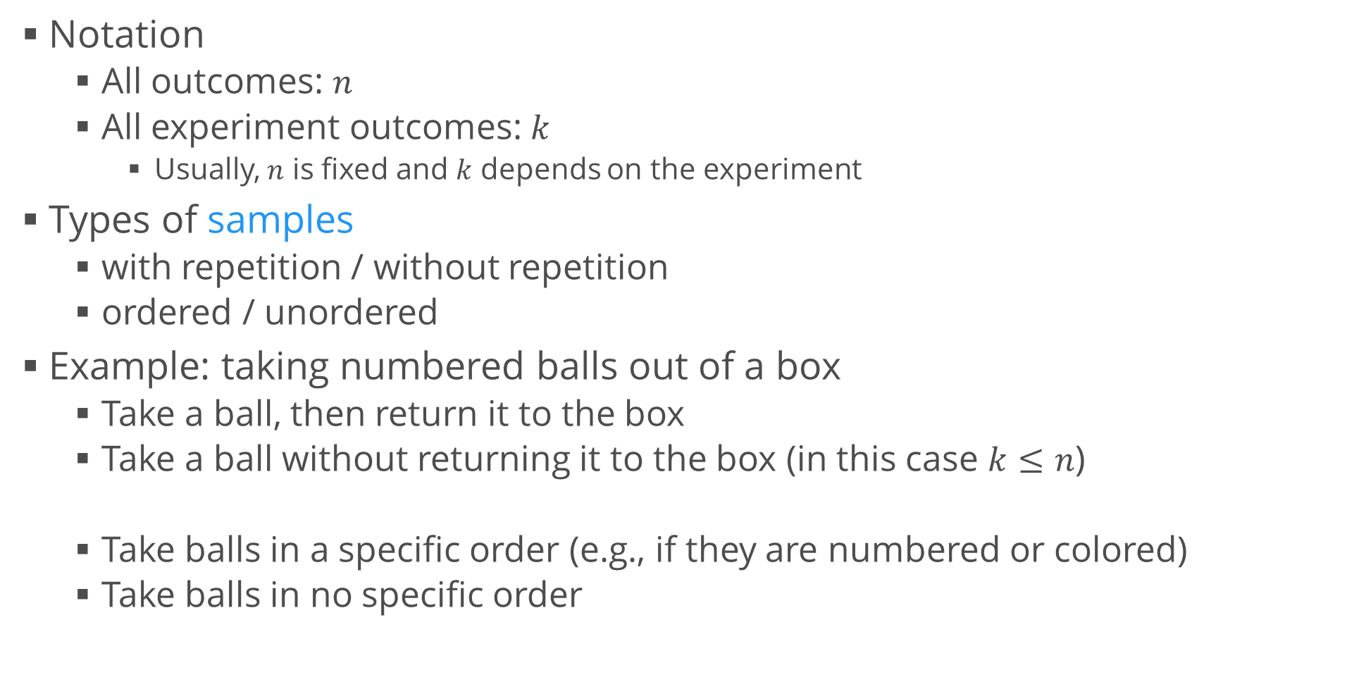
Combinatorics (2)
Notation
All outcomes: $n$
All experiment outcomes: $k$
Usually, $n$ is fixed and $k$ depends on the experiment
Types of samples
with repetition / without repetition
ordered / unordered
Example: taking numbered balls out of a box
Take a ball, then return it to the box
Take a ball without returning it to the box (in this case $k≤n$)
Take balls in a specific order (e.g., if they are numbered or colored)
Take balls in no specific order

Slide 14
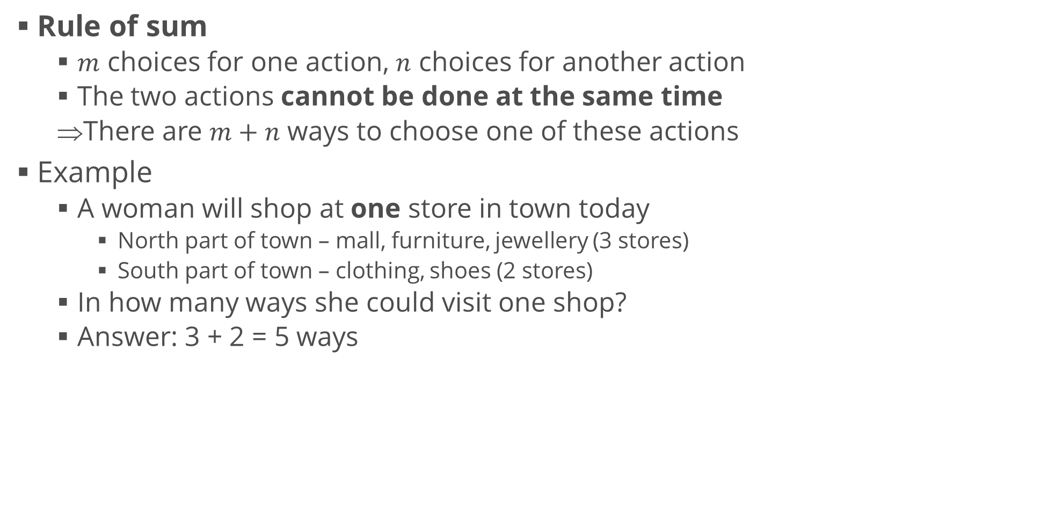
Counting Rules
Rule of sum
$m$ choices for one action, $n$ choices for another action
The two actions cannot be done at the same time
There are $m+n$ ways to choose one of these actions
Example
A woman will shop at one store in town today
North part of town – mall, furniture, jewellery (3 stores)
South part of town – clothing, shoes (2 stores)
In how many ways she could visit one shop?
Answer: 3 + 2 = 5 ways

Slide 15
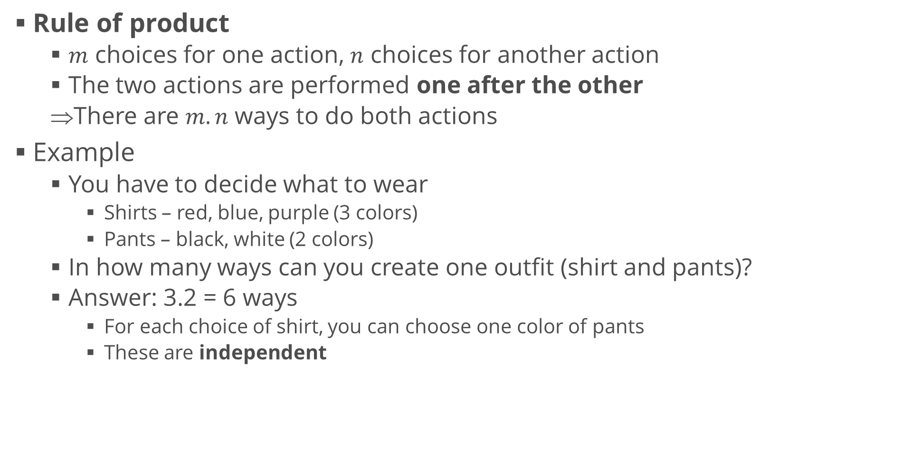
Counting Rules (2)
Rule of product
$m$ choices for one action, $n$ choices for another action
The two actions are performed one after the other
There are $m.n$ ways to do both actions
Example
You have to decide what to wear
Shirts – red, blue, purple (3 colors)
Pants – black, white (2 colors)
In how many ways can you create one outfit (shirt and pants)?
Answer: 3.2 = 6 ways
For each choice of shirt, you can choose one color of pants
These are independent

Slide 16
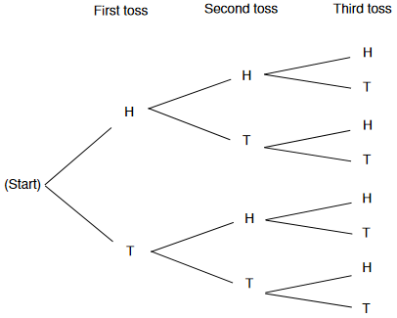
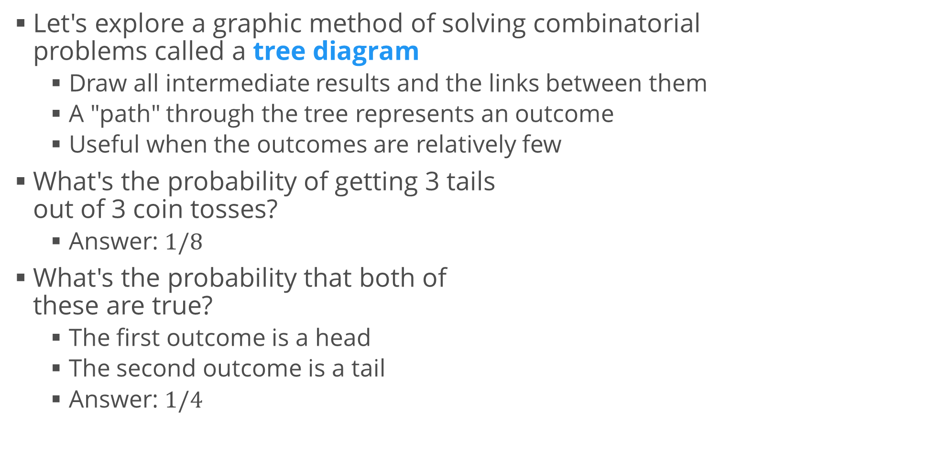
Example: Three Coin Tosses
Let's explore a graphic method of solving combinatorial problems called a tree diagram
Draw all intermediate results and the links between them
A "path" through the tree represents an outcome
Useful when the outcomes are relatively few
What's the probability of getting 3 tails out of 3 coin tosses?
Answer: $1/8$
What's the probability that both of these are true?
The first outcome is a head
The second outcome is a tail
Answer: $1/4$

Slide 17
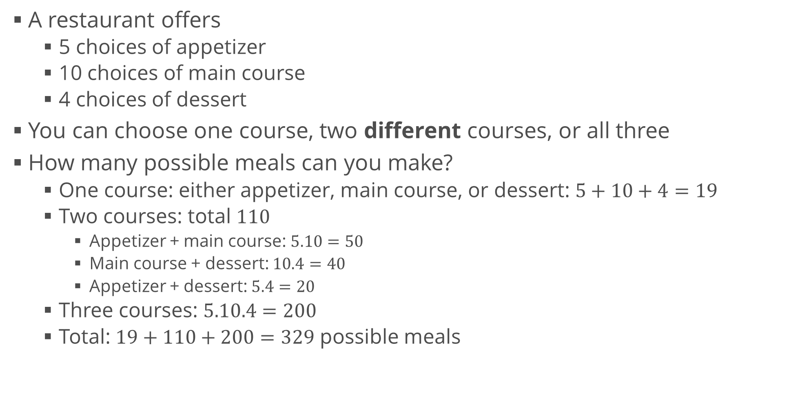
Example 2: Eating at a Restaurant
A restaurant offers
5 choices of appetizer
10 choices of main course
4 choices of dessert
You can choose one course, two different courses, or all three
How many possible meals can you make?
One course: either appetizer, main course, or dessert: $5+10+4=19$
Two courses: total $110$
Appetizer + main course: $5.10=50$
Main course + dessert: $10.4=40$
Appetizer + dessert: $5.4=20$
Three courses: $5.10.4=200$
Total: $19+110+200=329$ possible meals

Slide 18
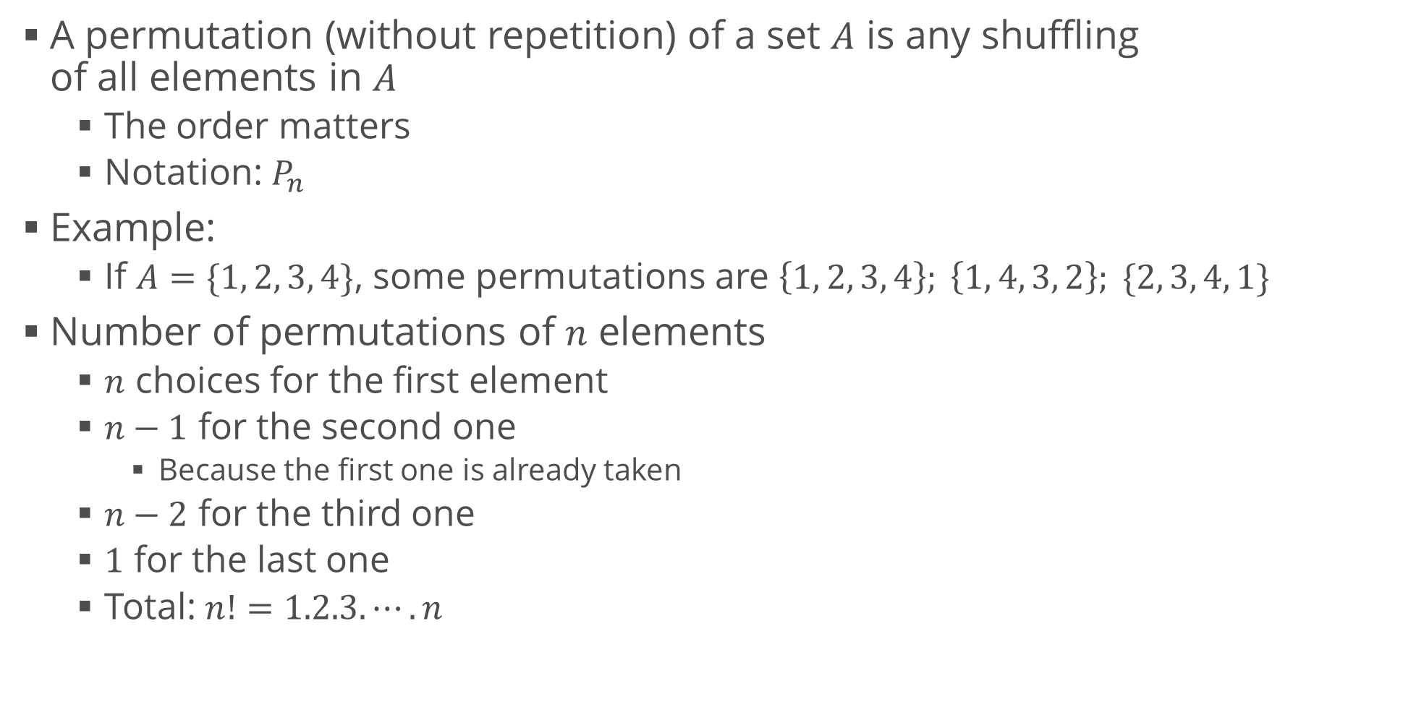
Permutations
A permutation (without repetition) of a set $A$ is any shuffling of all elements in $A$
The order matters
Notation: $P_{n}$
Example:
If $A=\{1, 2, 3, 4\}$, some permutations are $\left\{1, 2, 3, 4\right\}; \left\{1, 4, 3, 2\right\}; \{2, 3, 4, 1\}$
Number of permutations of $n$ elements
$n$ choices for the first element
$n−1$ for the second one
Because the first one is already taken
$n−2$ for the third one
$1$ for the last one
Total: $n!=1.2.3.⋯.n$

Slide 19
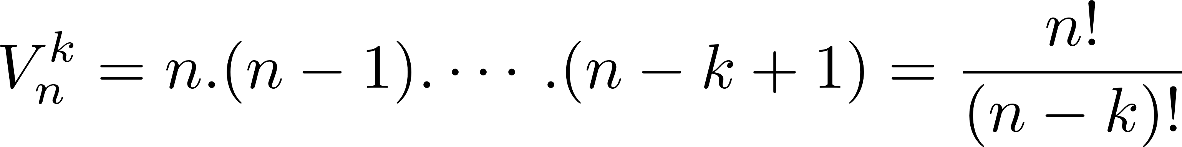
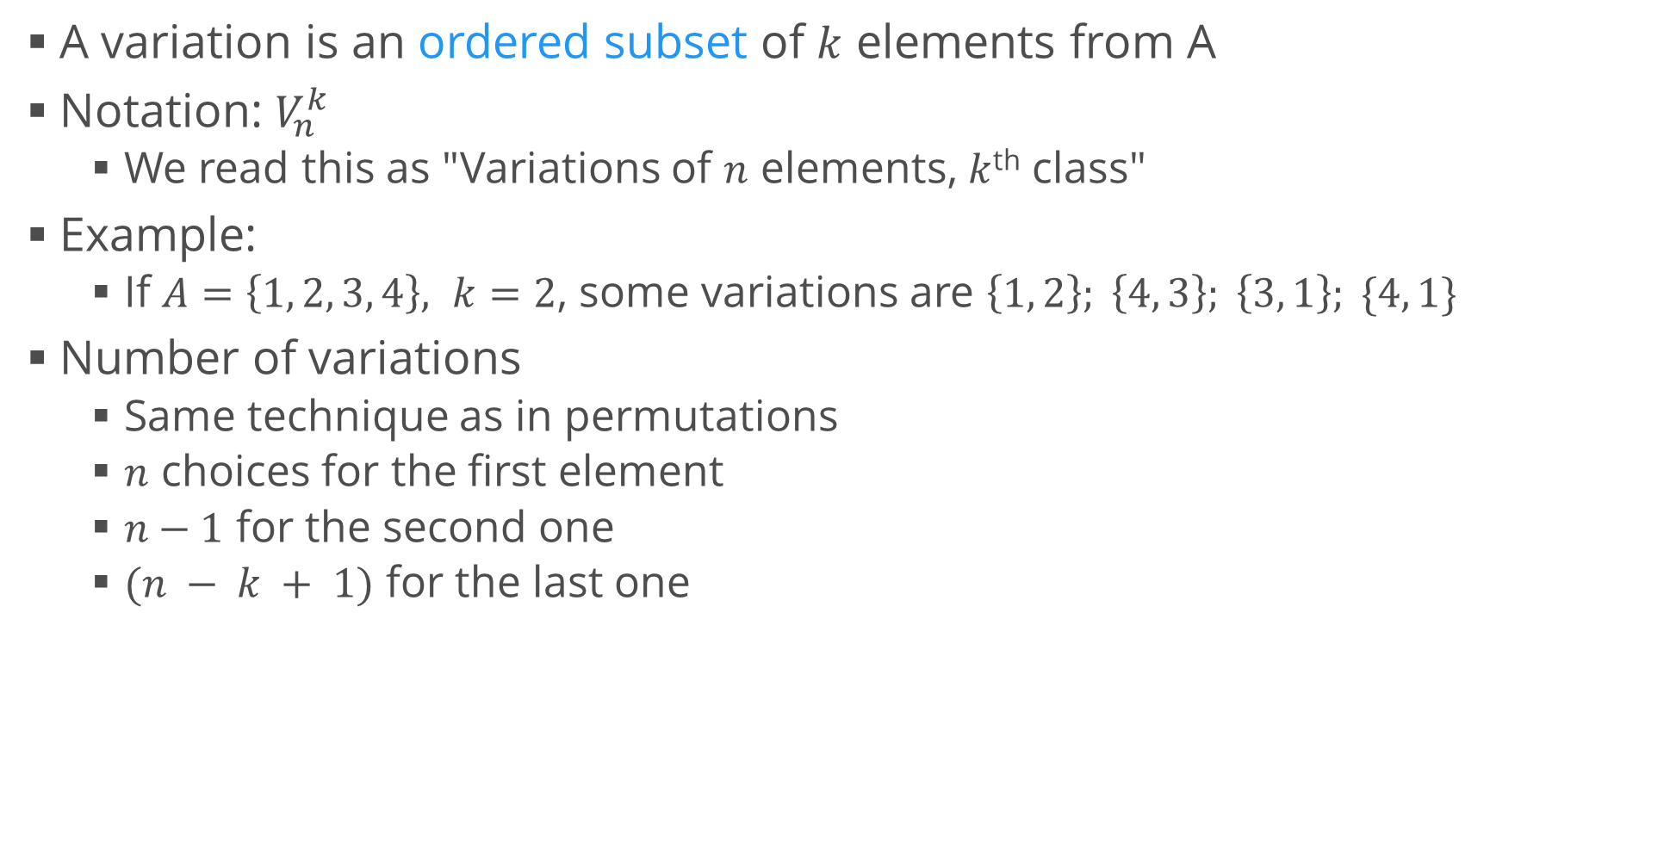
Variations
A variation is an ordered subset of $k$ elements from A
Notation: $V_{n}^{k}$
We read this as "Variations of $n$ elements, $k$^{th} class"
Example:
If $A=\left\{1, 2, 3, 4\right\}, k=2$, some variations are $\left\{1, 2\right\}; \left\{4, 3\right\}; \left\{3, 1\right\}; \{4, 1\}$
Number of variations
Same technique as in permutations
$n$ choices for the first element
$n−1$ for the second one
$(n − k + 1)$ for the last one

Slide 20
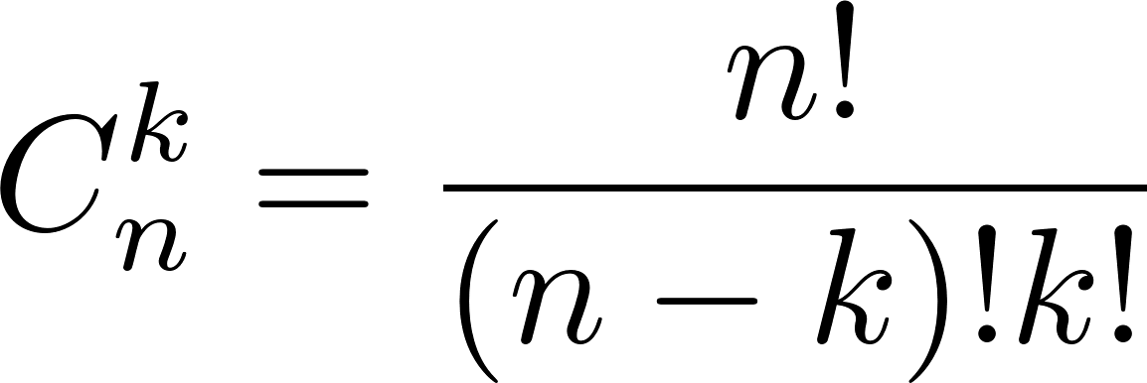
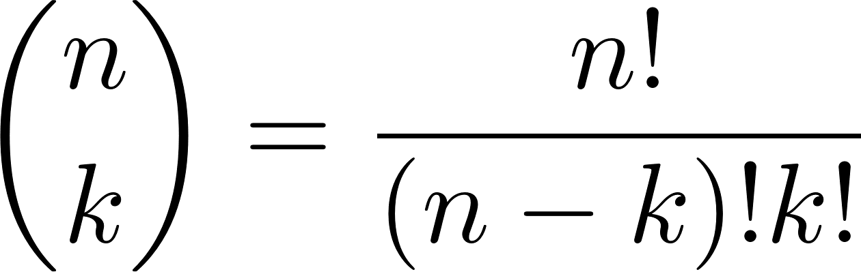
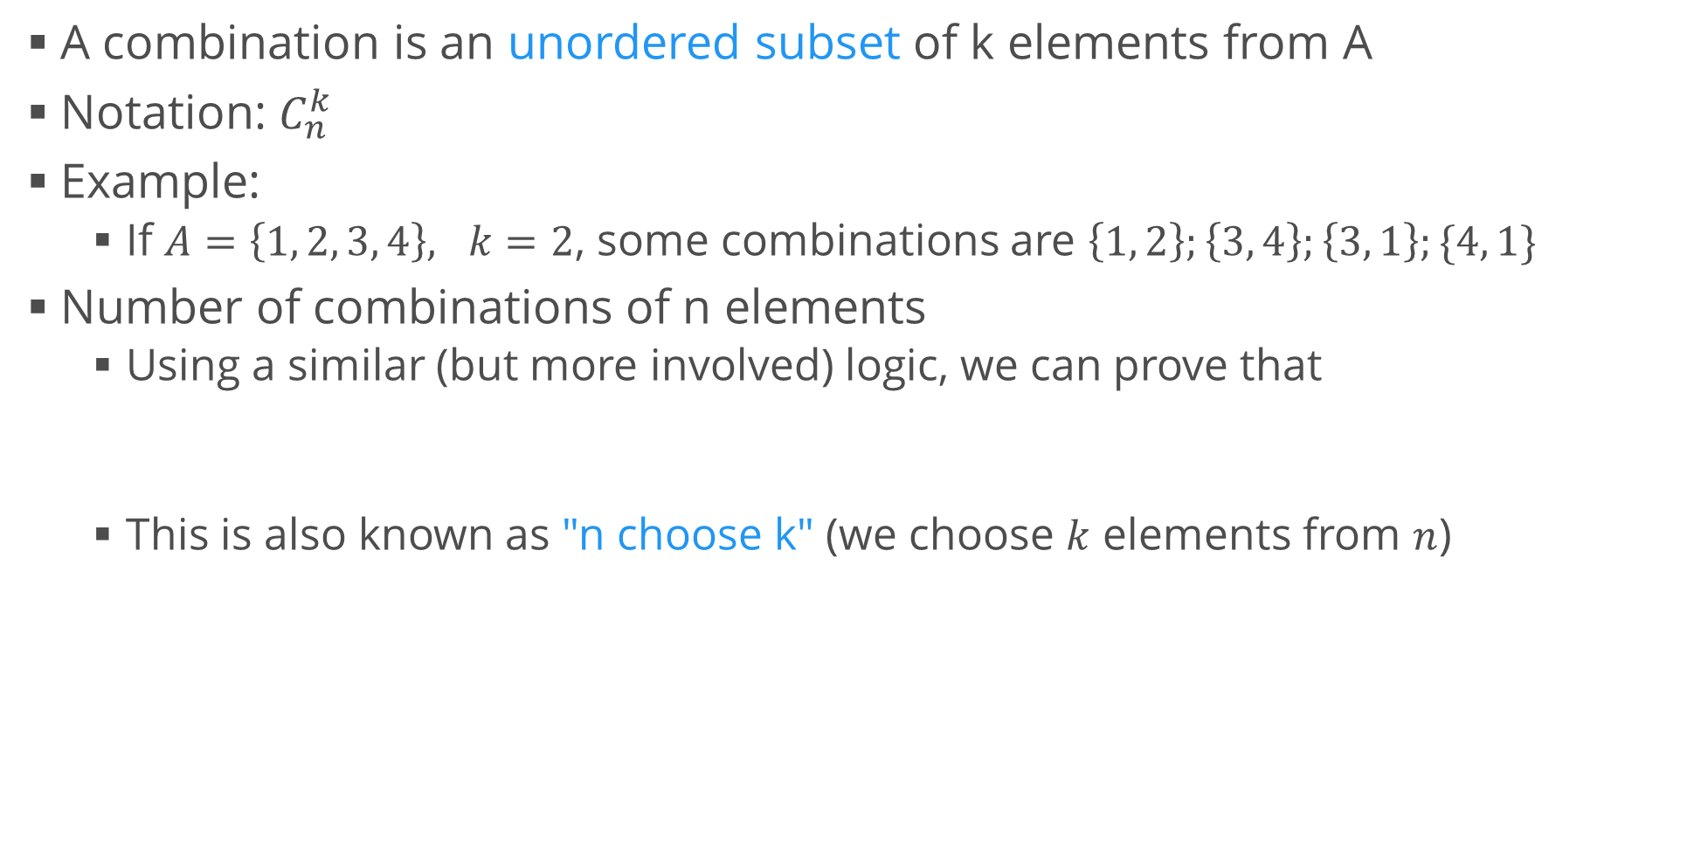
Combinations
A combination is an unordered subset of k elements from A
Notation: $C_{n}^{k}$
Example:
If $A=\left\{1, 2, 3, 4\right\}, k=2$, some combinations are $\left\{1, 2\right\};\left\{3, 4\right\};\left\{3, 1\right\};\{4, 1\}$
Number of combinations of n elements
Using a similar (but more involved) logic, we can prove that
This is also known as "n choose k" (we choose $k$ elements from $n$)

Slide 21
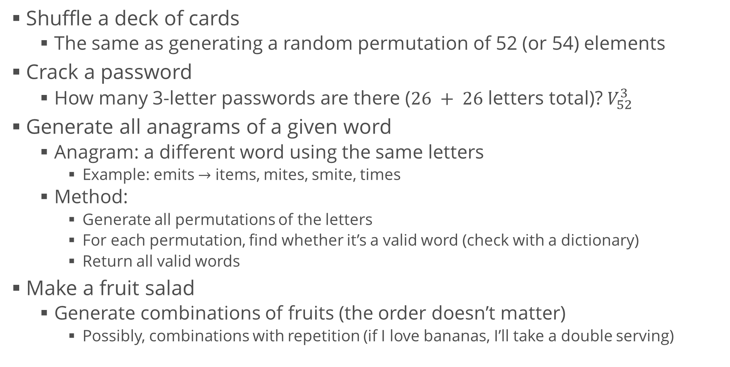
Example Usages
Shuffle a deck of cards
The same as generating a random permutation of 52 (or 54) elements
Crack a password
How many 3-letter passwords are there ($26 + 26$ letters total)? $V_{52}^{3}$
Generate all anagrams of a given word
Anagram: a different word using the same letters
Example: emits $→$ items, mites, smite, times
Method:
Generate all permutations of the letters
For each permutation, find whether it’s a valid word (check with a dictionary)
Return all valid words
Make a fruit salad
Generate combinations of fruits (the order doesn’t matter)
Possibly, combinations with repetition (if I love bananas, I’ll take a double serving)

Slide 22
Probability Algebra
Sets and probabilities, geometry intuition

Slide 23
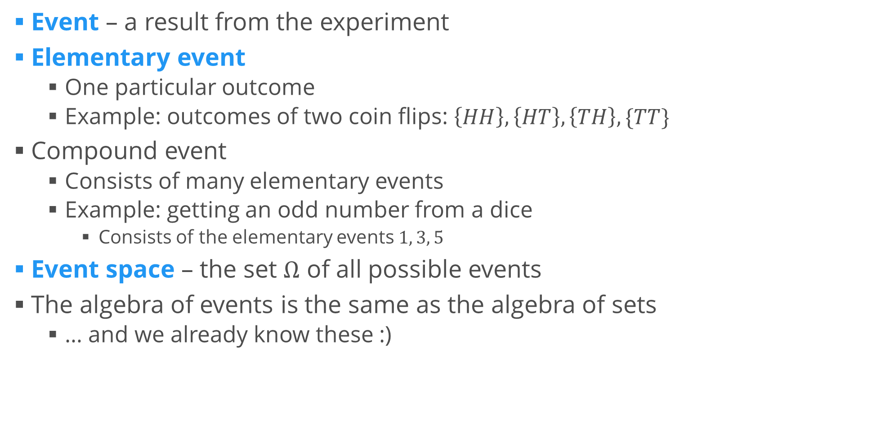
Events
Event – a result from the experiment
Elementary event
One particular outcome
Example: outcomes of two coin flips: $\left\{HH\right\}, \left\{HT\right\}, \left\{TH\right\}, \{TT\}$
Compound event
Consists of many elementary events
Example: getting an odd number from a dice
Consists of the elementary events $1, 3, 5$
Event space – the set $Ω$ of all possible events
The algebra of events is the same as the algebra of sets
… and we already know these :)

Slide 24
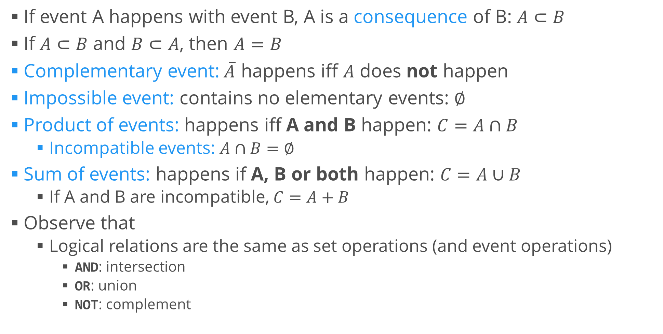
Algebra of Events
If event A happens with event B, A is a consequence of B: $A⊂B$
If $A⊂B$ and $B⊂A$, then $A=B$
Complementary event:$\overline{A}$ happens iff $A$ does not happen
Impossible event: contains no elementary events: $∅$
Product of events: happens iff A and B happen: $C=A∩B$
Incompatible events: $A∩B=∅$
Sum of events: happens if A, B or both happen: $C=A∪B$
If A and B are incompatible, $C=A+B$
Observe that
Logical relations are the same as set operations (and event operations)
AND: intersection
OR: union
NOT: complement

Slide 25
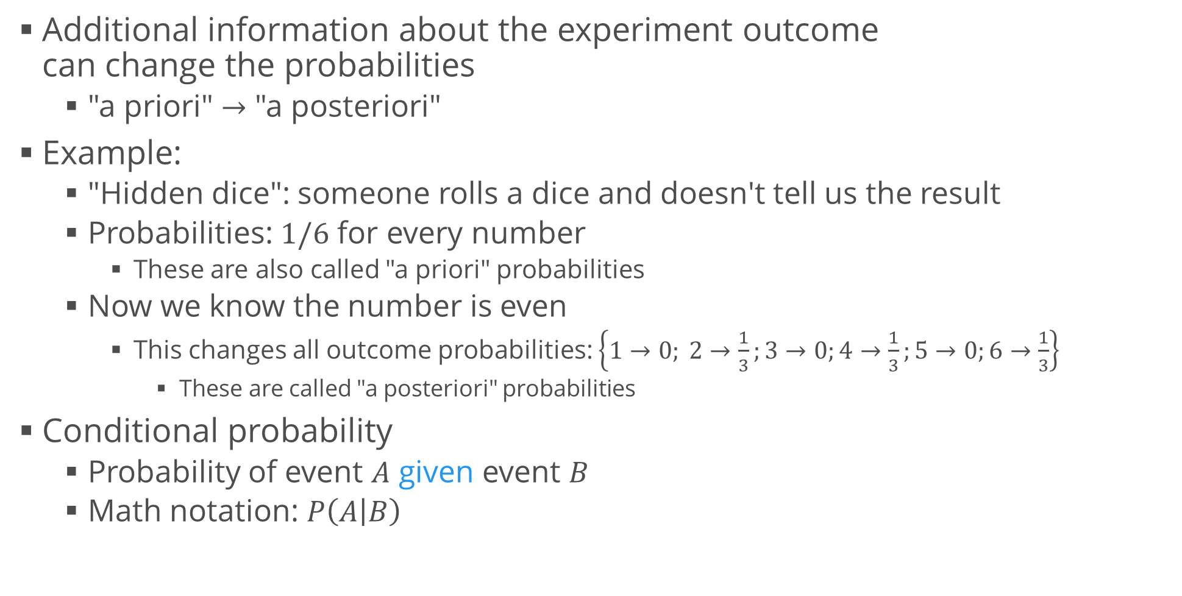
Conditional Probability
Additional information about the experiment outcome can change the probabilities
"a priori" $→$ "a posteriori"
Example:
"Hidden dice": someone rolls a dice and doesn't tell us the result
Probabilities: $1/6$ for every number
These are also called "a priori" probabilities
Now we know the number is even
This changes all outcome probabilities: $\left\{1→0; 2→\frac{1}{3};3→0;4→\frac{1}{3};5→0;6→\frac{1}{3}\right\}$
These are called "a posteriori" probabilities
Conditional probability
Probability of event $A$ given event $B$
Math notation: $P\left(A | B\right)$

Slide 26
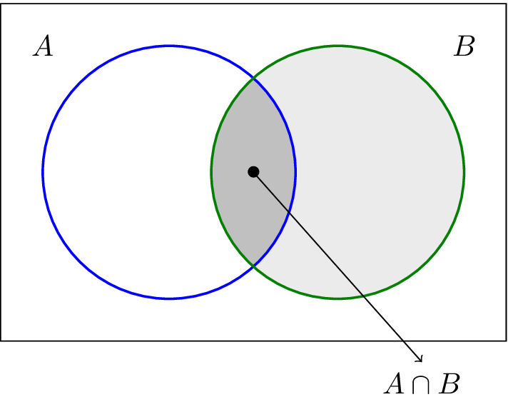
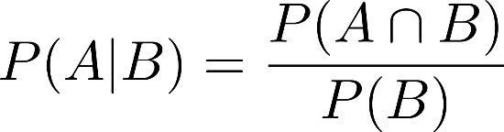
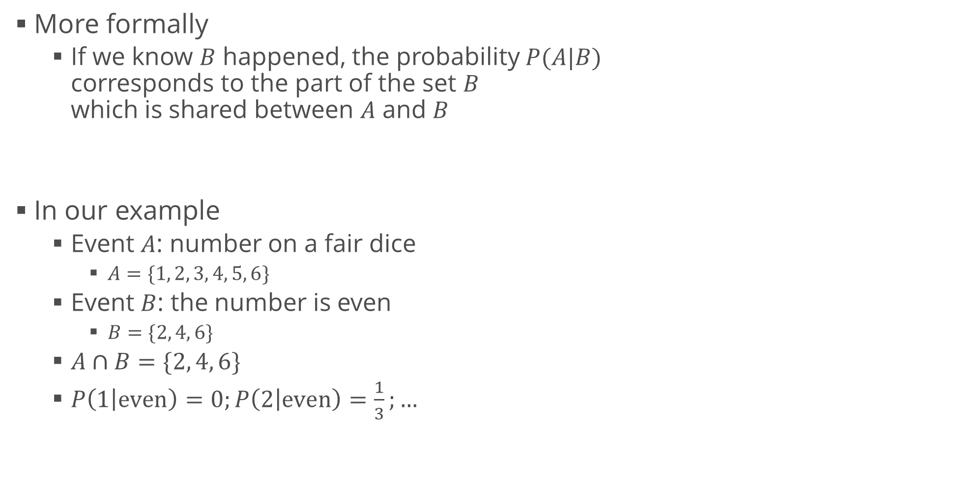
Conditional Probability (2)
More formally
If we know $B$ happened, the probability $P(A|B)$ corresponds to the part of the set $B$ which is shared between $A$ and $B$
In our example
Event $A$: number on a fair dice
$A=\{1, 2, 3, 4, 5, 6\}$
Event $B$: the number is even
$B=\{2, 4, 6\}$
$A∩B=\{2, 4, 6\}$
$P\left(1 | even\right)=0;P\left(2 | even\right)=\frac{1}{3};…$

Slide 27
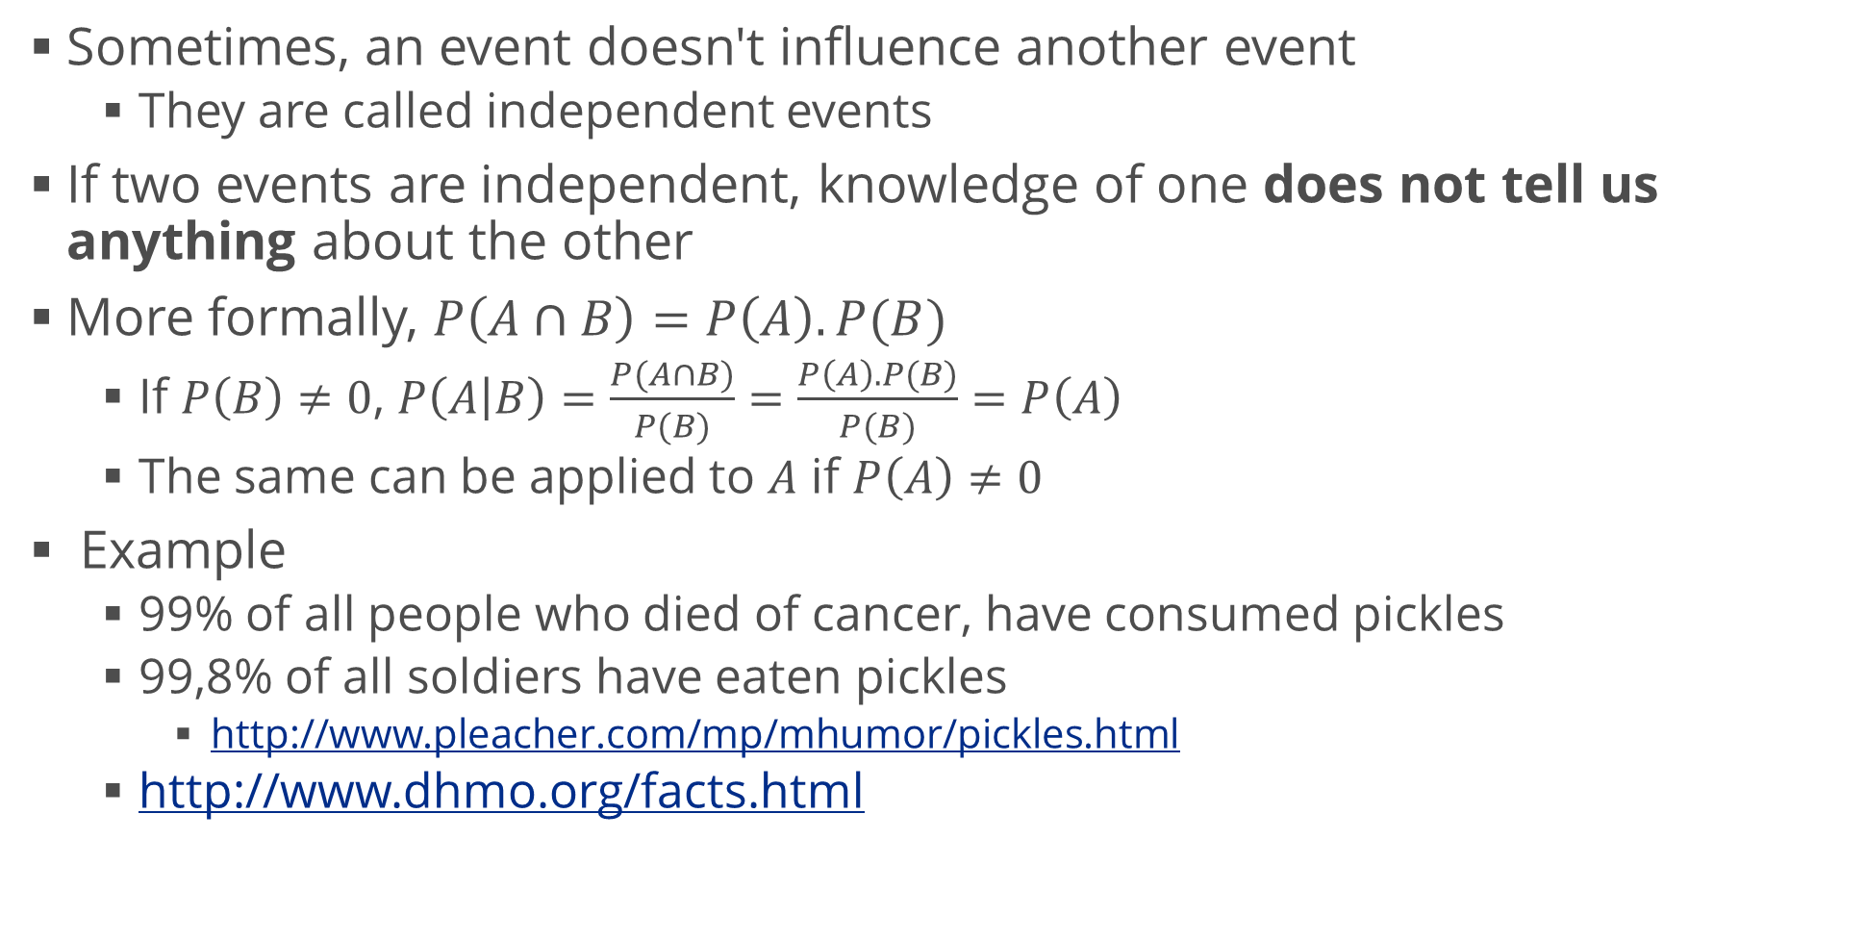
Event Independence
Sometimes, an event doesn't influence another event
They are called independent events
If two events are independent, knowledge of one does not tell us anything about the other
More formally, $P\left(A∩B\right)=P\left(A\right).P(B)$
If $P\left(B\right)≠0$, $P\left(A | B\right)=\frac{P(A∩B)}{P(B)}=\frac{P\left(A\right).P(B)}{P(B)}=P\left(A\right)$
The same can be applied to $A$ if $P\left(A\right)≠0$
Example
99% of all people who died of cancer, have consumed pickles
99,8% of all soldiers have eaten pickles
http://www.pleacher.com/mp/mhumor/pickles.html
http://www.dhmo.org/facts.html

Slide 28
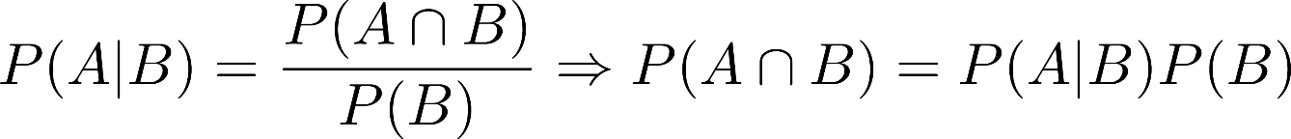
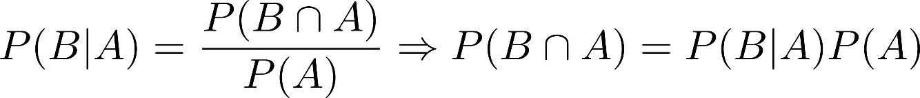
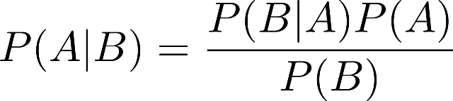
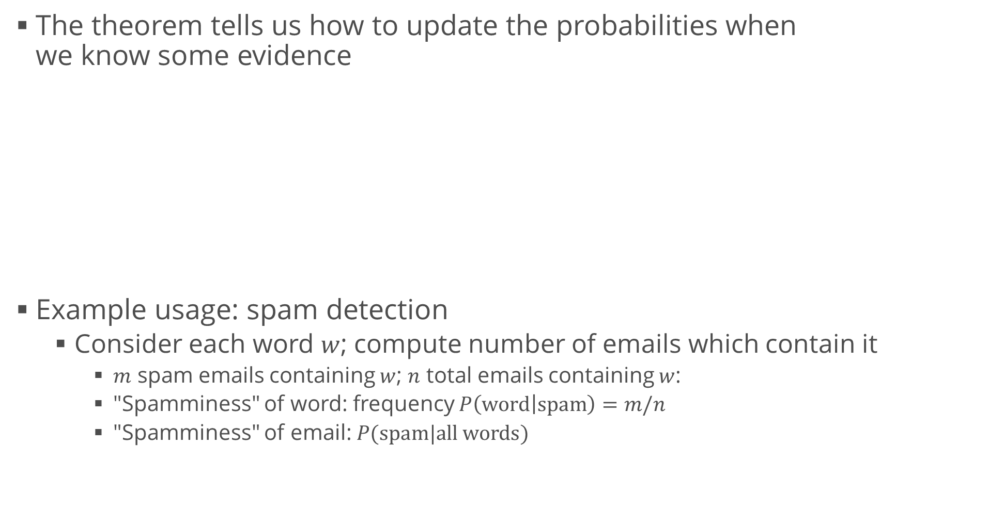
Bayes’ Theorem
The theorem tells us how to update the probabilities when we know some evidence
Example usage: spam detection
Consider each word $w$; compute number of emails which contain it
$m$ spam emails containing $w$; $n$ total emails containing $w$:
"Spamminess" of word: frequency $P\left(word | spam\right)=m/n$
"Spamminess" of email: $P(spam|all words)$

Slide 29
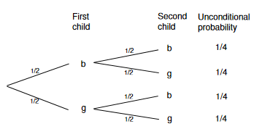
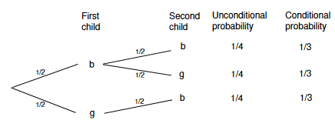
Example: Family Paradox 1
A family has two children
One of them is a boy
What is the probability that both children are boys?
A child has a 0,5 chance of being a boy or a girl
Intuitive answer: 0,25
But wait… let's exhaust all possibilities

Slide 30
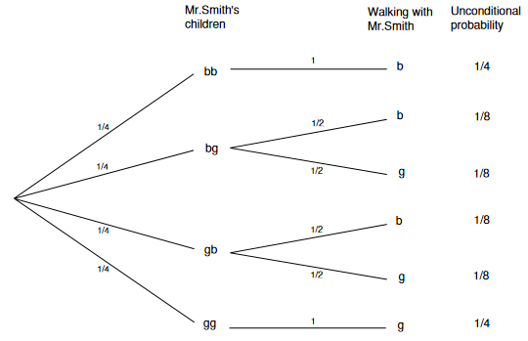
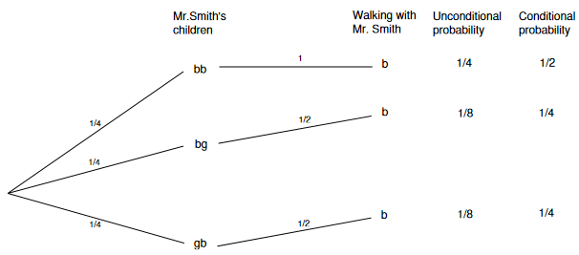
Example: Family Paradox 2
Mr. Smith is the father of two children
When we meet him on the street, he introduces one as his son
What's the probability that the other child is a boy?
Assumption
He is equally likely to take any child to a walk

Slide 31

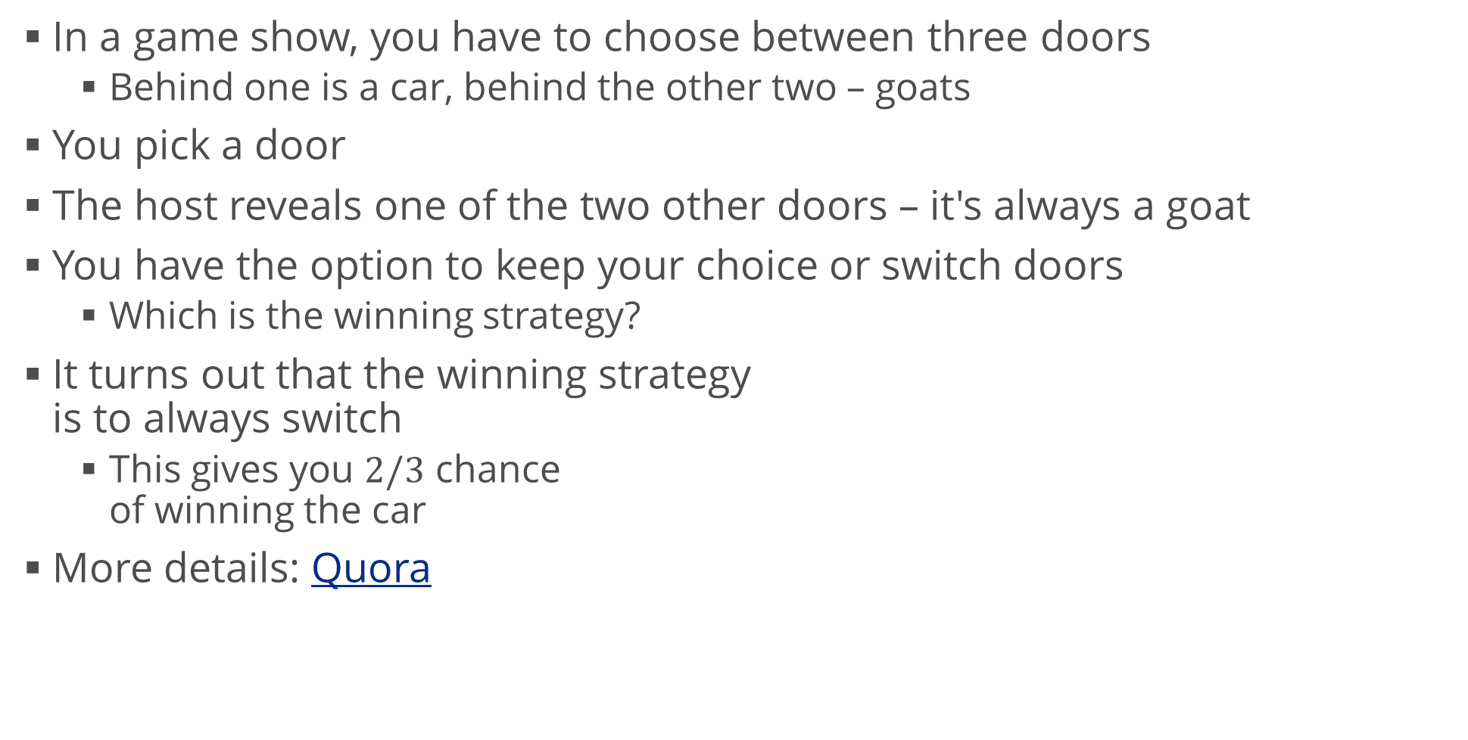
Example: Monty Hall Problem
In a game show, you have to choose between three doors
Behind one is a car, behind the other two – goats
You pick a door
The host reveals one of the two other doors – it's always a goat
You have the option to keep your choice or switch doors
Which is the winning strategy?
It turns out that the winning strategy is to always switch
This gives you $2/3$ chance of winning the car
More details: Quora

Slide 32
Statistical Distributions
Seeing the results of our experiments

Slide 33
Distributions
We saw that random variables can be treated as functions
But they look funky
Don’t have derivatives at most points
Difficult to work with
We can instead take functions of these functions
Like we counted each outcome
Instead of graphing the real function, we made a histogram of counts
This gives us a much better idea what the random variable looks like
These functions of functions are called distributions
In our example, we looked at the frequency distribution

Slide 34
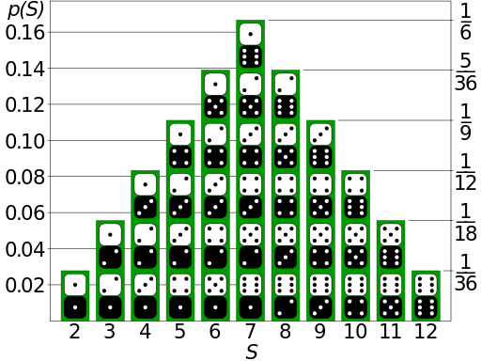
Discrete Distribution
Probability distribution function
A table which maps each outcome of a random variable to a probability: $p_{X}\left(x_{i}\right)=P(X=x_{i})$
Also called probability mass function (pmf)
Example: two die rolls
Random variable: sum of numbers
Outcomes: $\{2, 3, …, 12\}$
Probabilities:

Slide 35
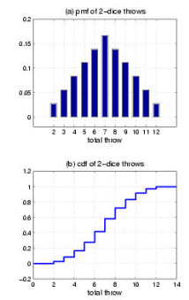
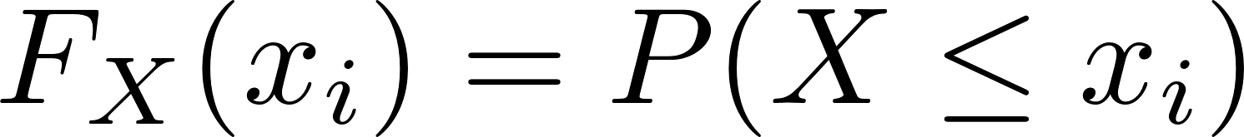
Discrete Distribution (2)
Cumulative distribution function
A table which maps each outcome of a random variable to the probability of its value being less than or equal to a given number
Also called cumulative mass function (cmf) or cumulative density function (cdf)
Every cmf is non-decreasing
Usually starts at 0
Always ends at 1

Slide 36
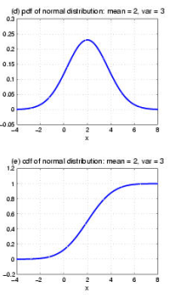
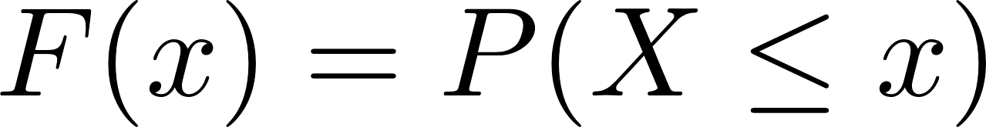
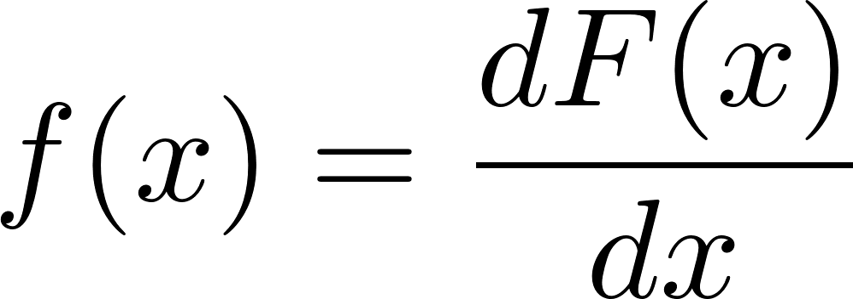
Continuous Distribution
Cumulative density function (cdf)
Defined in the same way as the cmf:
Probability density function
Derivative of the cdf:
Meaning: the probability of the function taking values in an infinitely small interval around $x$
The probability of observing any single value $a$ is exactly 0
The number of outcomes is $∞$
$p\left(a\right)=\left[\frac{\# of values a}{∞}\right]=0$

Slide 37
Common Distributions
Probability and Statistics Playing Together

Slide 38
Bernoulli and Uniform Distributions
Bernoulli distribution
The simplest distribution of a random variable
Value $0$ with probability $p$
Value $1$ with probability $q = 1 – p$
The two events are incompatible (mutually exclusive)
Example: coin flip (fair coin: $p = 0,5$)
… Not so interesting on its own
But takes part in other distributions
Uniform distribution
All values in some range $[a;b]$ are equally likely
Example: number on a fair dice
Also generalizes to continuous variables

Slide 39
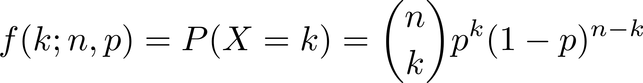
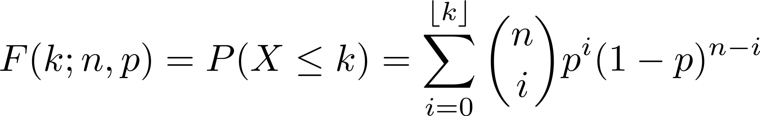
Binomial Distribution
$n$ Bernoulli trials
Each trial has a "success" probability $p$
$n = 1 ⇒$ Bernoulli distribution
Discrete distribution
Notation: $X\sim B(n, p)$
"X follows the binomial distribution with parameters $n$ and $p$"
Probability mass function
Cumulative function

Slide 40
Normal Distribution ♥
Origin: random errors in measurements
When we perform an experiment, there are many sources of error
Example: throwing a dart at the origin of the $(x,y)$-plane
We aim at the origin
Random errors prevent us from hitting it every time
Sources of error
Hand shaking, air currents, distribution of mass inside the arrow, different viewing angles… and many more, some of which we can’t even know
Assumptions
The errors don’t depend on the orientation of the coordinate system
The errors in $x$ and $y$ directions are independent: one doesn’t influence the other
Large errors are less likely than small errors

Slide 41

Normal Distribution (2)
We can derive the distribution of errors
Distances from the origin
Normal (Gaussian) distribution
pdf: $p\left(x;μ,σ\right)=\frac{1}{σ\sqrt{2π}}e^{−{\frac{1}{2}\left(\frac{x−μ}{σ}\right)}^{2}}$
$μ,σ$ – parameters
We’ll see their real meaning next time
cdf: doesn’t exist as a function, we can integrate numerically
Complete derivation of the formula: here
Standard normal distribution: $μ=0, σ=1$
Mainly for convenience

Slide 42
Central Limit Theorem
The sum of many independent random variables tends to a normal distribution even if the original random variables are not normally distributed
In other words: The sampling distribution of the mean of any independent random variable will be normal or nearly normal if the sample is large enough
Large enough?
$n∈[30;40]$ for most statisticians, but more is better
Example: customers in a shop
Every customer has their own behavior, reasons, money, etc.
We can treat them as random variables with unknown distributions
The shop's earnings are approximately normally distributed
If there are many customers
We don’t even care about the many sources of error: they will produce a normal distribution anyway

Slide 43
Summary
Probability
Combinatorics
Algebra of events
Conditional probability
Applications
Statistical distributions
Central limit theorem

